Slide 1

Decision Trees

Slide 2
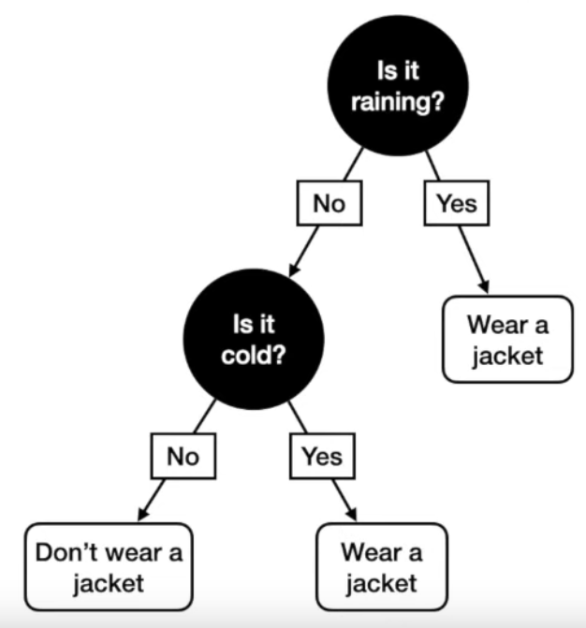
A Decision Tree is in essence a sequence of yes/no questions that can guide a decision
This is quite simple, yes? Good!
Because we can generalize this simple concept into powerful ML models

Slide 3
Classification

Slide 4
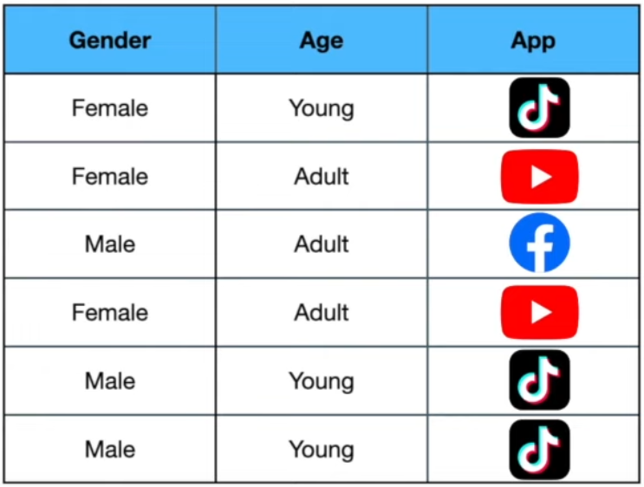
Classification
Let’s begin with trying to build a classification model.
Below, we have a dataset with the prefered social media app for some users.
We’re going to try to build a model that can predict the prefered App for any user given the features Gender & Age
Note: this is actually multi-class classification! Decision Tree’s can handle both binary and multi-class classification equally well.
Our training data

Slide 5
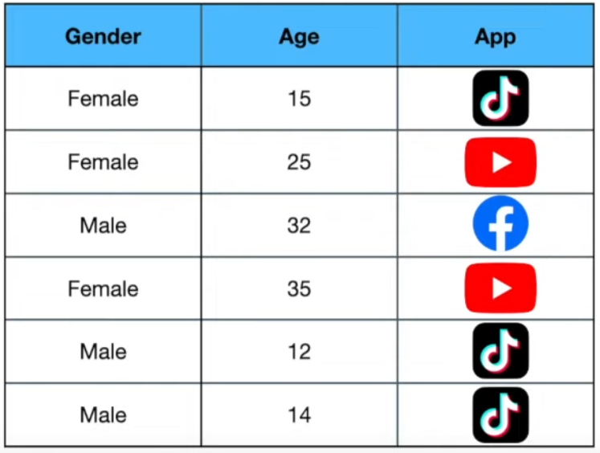
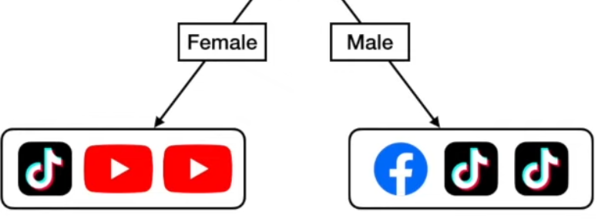
Classification
To make it simple at first, let’s assume we only have the feature Gender.
A decision tree classifier then start’s off by asking a simple yes/no question about that feature – and then sort all our training samples according to that question.
Our training data
Gender = Female
Yes
No

Slide 6
Classification
Great, we have now split all our training samples according to our question. But how do we interpret this result?
According to our training data we see that the most prefered app for Females is Youtube.
This model has finished training!
Gender = Female
Therefore, for any new unseen test sample, our tree will predict the prefered App of all Females to be Youtube!
By the same logic, we will predict the prefered App for all Males to be TikTok.
Yes
No
P(Youtube|Female) = 2/3
P(TikTok|Female) = 1/3
P(Facebook|Female) = 0/3
P(Youtube|Male) = 0/3
P(TikTok|Male) = 2/3
P(Facebook|Male) = 1/3

Slide 7
Classification
A question in a Decision Tree is called a Decision Node.
A Decision tree with only one question (Decision node) is called a Decision Tree Stump.
This model has finished training!
Gender = Female
However, sometimes, it’s not enough to simply ask a question about a single feature to get an accurate answer. We can utilize several features!
Yes
No
P(Youtube|Female) = 2/3
P(TikTok|Female) = 1/3
P(Facebook|Female) = 0/3
P(Youtube|Male) = 0/3
P(TikTok|Male) = 2/3
P(Facebook|Male) = 1/3

Slide 8
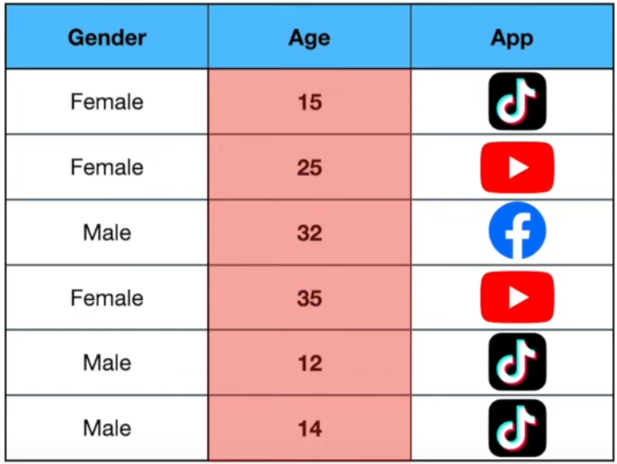
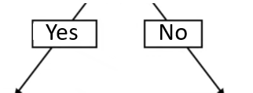





Classification
Gender = Female
In general, having more good features is better in a Decision tree!
Yes
No
Our training data
Age = Young
Age = Young
We get new prediction probabilities

Slide 9
Classification
Gender = Female
Okay, but how do we handle numerical features? Easy.
Yes
No
Age <= 31
Age <= 31

Slide 10
In Decision Trees, many implementations actually do support categorical columns. However, sklearn’s documentation states that their implementation does not support it for now.
→ You have to transform all your categorical columns (both features and target) to numerical, before training as part of the data pre-processing.
All features can be one-hot-encoded, as usual. However, the target column (for classification tasks) simply gets a single number – one for each class.
0
0
0
1
1
2
0
1
1
0
1
0
https://scikit-learn.org/stable/modules/tree.html

Slide 11
Regression

Slide 12
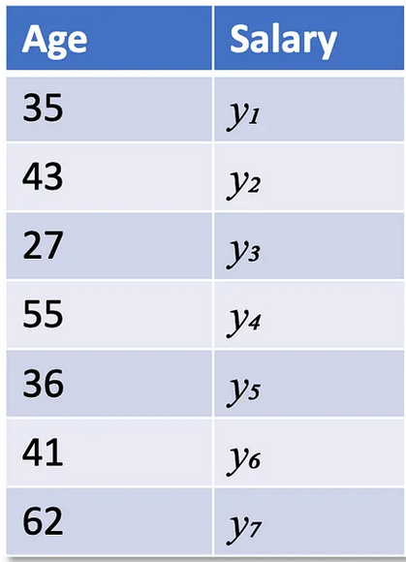
Regression
For regression tasks, almost everything works precisely the same as for classification tasks. The only difference is the actual prediction.
We need a continous output for regression tasks.
Our training data

Slide 13
Regression
A trained Decision Tree Stump
Age <= 36
Our training data
Yes
No
y1, y3, y5
y2, y4, y6
y_hat = mean(y1, y3, y5)
y_hat = mean(y2, y4, y6)
According to our training data we would now predict the Salary for new unseen test samples as the mean’s defined above!
We could of course use as many good features as we want here, aswell!

Slide 14
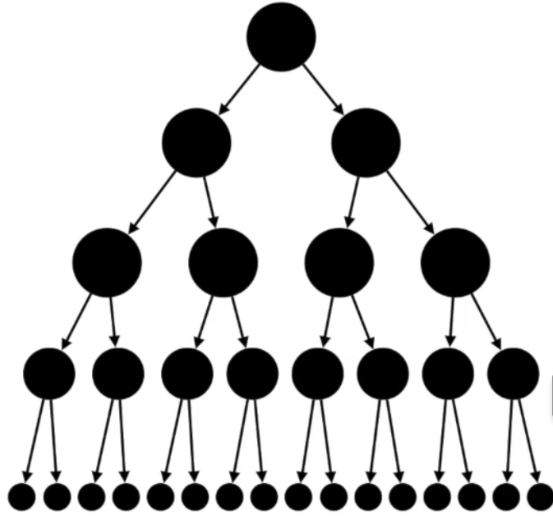
Takeaways
In general, a Decision Tree can have many decision nodes.
The number of decision nodes is called the Decision Tree’s depth.
Having too few decision nodes can lead to an underfit model
However, having too many decision nodes can lead to overfitting!
It is your job to find the optimal depth for each tree
You can control the allowed depth for a decision tree via a parameter in sklearn

Slide 15
The syntax for importing Decision Tree’s is simple and familiar
Classification
Regression
from sklearn.tree import DecisionTreeClassifier
model = DecisionTreeClassifier(max_depth=4)
model.fit(X_train, y_train)
from sklearn.tree import DecisionTreeRegressor
model = DecisionTreeClassifier(max_depth=4)
model.fit(X_train, y_train)
After fitting, we can predict on both our train and test set, and then calculate accuracy, precision, recall, confusion matrix etc. to evaluate our model
After fitting, we can predict on both our train and test set, and then calculate MAE, MSE etc. evaluate our model

Slide 16
Överkurs
Okey, but how do we actually choose the correct questions to ask at each decision node?

Slide 17
Överkurs
The short answer is that this is done automatically, using mathematical measures called Gini, Entropy or Log Loss.
In short, they make sure that each decision nodes asks precisely the question that implies maximum splitting of the training samples.
You can read more about this in the references found in this weeks resources. You can also search for more information yourself.

